Slide 1
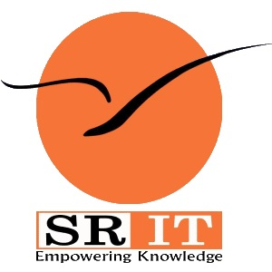
Process Mining
by
G Vamsi Krishna
Roll No. 224G5A3214
Department of Computer Science and Engineering (Data Science)
Srinivasa Ramanujan Institute of Technology
(Affiliated to JNTUA & Approved by AICTE) (Accredited by NAAC with ‘A’ Grade & Accredited by NBA (EEE, ECE & CSE)
Rotarypuram Village, B K Samudram Mandal, Ananthapuramu – 515701.
2023 - 2024

Slide 2

Contents
Course Objective
Introduction
Technology
Applications
Modules
Real Time applications
Learning outcomes
GitHub Link
Queries

Slide 3
Course Objective
The Celonis process mining software helps us find and capture value fast by improving the performance of your core business processes.
Process mining applies data science to discover, validate and improve workflows.
We can learn how to use the different explorers in Celonis i.e., Variant Explorer,
Process Explorer and Case Explorer.
The ability to comprehend and implement the PQL for our use in Celonis and
to distinguish it from SQL.

Slide 4
Introduction
What is Celonis ?
Celonis is a software company that specializes in process mining and process optimization.
It was founded in 2011 by Bastian Nominacher, Martin Klenk, and Alexander Rinke in Munich, Germany
Celonis claims to be the world leader in process mining.
It offers a platform that leverages process mining techniques to help businesses gain a better understanding of their operational processes.
Celonis offers the Intelligent Business Cloud (IBC) platform, which encompasses several products and capabilities.
The company's goal is to help organizations transform their operations by leveraging data-driven insights to achieve greater efficiency and effectiveness.

Slide 5
contd…
What is Process Mining ?
Process mining holds significant importance for organizations across various
industries due to its ability to provide data-driven insights into their operations.
It aims to provide a comprehensive view of how processes are executed within an organization, highlighting the actual paths, variations, bottlenecks, and inefficiencies that occur during process execution.
Process mining enables organizations to bridge the gap between their intended or designed processes and their actual implementation.
It's particularly valuable in complex and dynamic environments where processes can be difficult to understand through traditional methods. Specialized process mining tools like Celonis, ProM, Disco, and others automate the analysis of event logs, generating visual process models and insights

Slide 6
Technology
Process mining utilizes a combination of techniques and technologies to analyse event logs and extract insights from processes. Here are the key technologies involved in process mining:
Event Log Data : These logs record various events, activities, and interactions in a structured format,usually with timestamps
Collection and Integration :
1.APIs (Application Programming Interfaces): APIs are used to collect data from different systems and integrate it into a unified format for analysis
2.ETL (Extract, Transform, Load) Tools: ETL tools help in extracting data from various sources, transforming it into a suitable format, and loading it into a central repository
Process Mining Software : Specialized process mining tools like Celonis, ProM, Disco, and others automate the analysis of event logs, generating visual process models and insights.

Slide 7
contd…
Process Visualization : Visualization libraries and tools help in creating interactive and informative visualizations of process data.
Machine Learning and AI : Machine learning algorithms can be applied for predictive analytics, anomaly detection, and clustering in process mining.
AI techniques enhance process discovery, conformance checking, and performance prediction
Data Storage and Management : Databases: Structured databases (SQL) or NoSQL databases store and manage event log data efficiently.Data warehouses enable centralized storage and analysis of data from various sources.
Cloud Computing : Cloud platforms such as AWS, Azure, and Google Cloud offer scalable infrastructure for storing and processing large volumes of data.

Slide 8
Applications
Financial Services: Companies in the financial services sector have the chance to continually and thoroughly identify issues within high-volume processes.
Telecommunications: Telecom companies get more orders, process mining gives them the chance to identify pricey issues and client blowback in their Order-to-Activation processes.
Healthcare: Process mining supports the delivery of effective and high-quality end-to-end patient journeys for healthcare organizations dealing with the exponential growth of data, from before a first doctor appointment through treatment regimens to closed treatment cases.
Digital Transformation: Process mining is frequently used in larger-scale digital transformation initiatives because it can give you the precise insights needed for process improvement, allowing systems to run more quickly, smoothly, and efficiently, as well as objective data-driven insights into the causes of delays and inefficiencies within business processes.

Slide 9
Modules
1. Process Mining Fundamentals :
The key fundamentals of process mining involves extracting insights from event data to
understand how processes function, identifying bottlenecks, inefficiencies, and opportunities for
optimization. Key components include data extraction, process discovery, conformance
checking, and process enhancement.

Slide 10
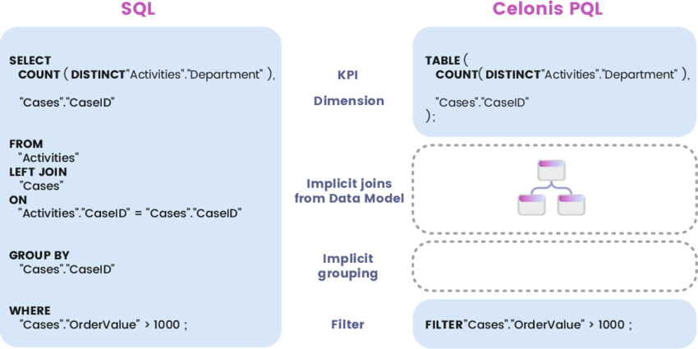
contd…
2. Rising Star Technical :
2.1 Celonis PQL Engine :
Celonis PQL is an integral component of the Celonis Software Architecture. All
Celonis applications use this language to query data from a data model.

Slide 11
contd…
2.2 SQL vs Celonis PQL : Celonis PQL does not support all operators that are available in SQL. This is because customer requirements drive the development of the language, and only operators needed for the target use cases are implementedSecond, Celonis PQL is not supported by a data manipulation language (DML). As all updates in the Process Mining scenario should come from the source systems, there is no need to manipulate and update the data through the query language directly.Furthermore, Celonis PQL does not provide any data definition language(DDL). As the data model is created by a visual data model editor and stored internally, there has not been any need for creating and modifying database objects.In contrast to SQL, Celonis PQL is domain-specific and offers a wide range of Process Mining operators not available in SQL. Consequently, Celonis PQL seamlessly integrates the data with the process perspective. Across all classes of operators, Celonis PQL follows four language features:
i. Operators usually create and return a single column that is either added to an existing table (e.g., the case or activity table) or to a new, temporary result table.
ii. The supported data types comprise STRING, INT, FLOAT, and DATE.
iii.Boolean values are not directly supported, but can be represented as integers. Each data type can hold NULL values.

Slide 12
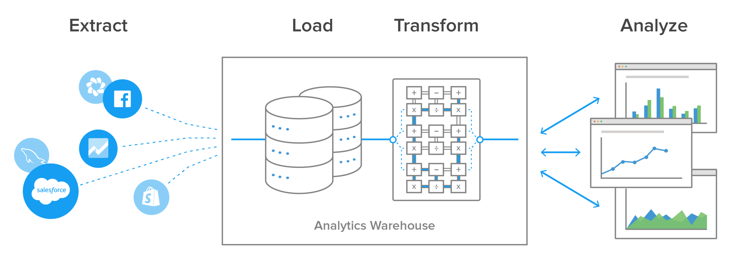
contd…
3 Get Data into the EMS
3.1 Data Extraction: Data extraction is the process of obtaining raw data from a source and replicating that data somewhere else. The raw data can come from various sources, such as a database, Excel spreadsheet, an SaaS platform, web scraping, or others. It can then be replicated to a destination, such as a data warehouse, designed to support online analytical processing (OLAP). This can include unstructured data, disparate types of data, or simply data that is poorly organized. Once the data has been consolidated, processed, and refined, it can be stored in a central location on-site, in cloud storage, or a hybrid of both to await transformation or further processing.

Slide 13
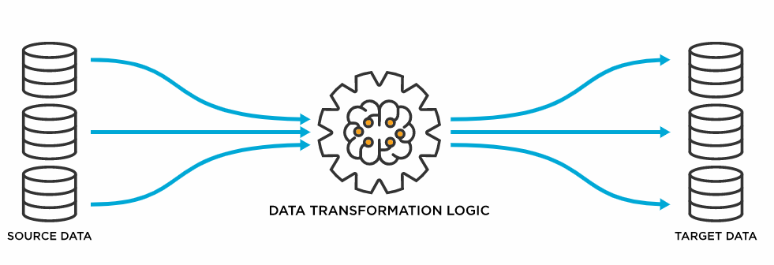
contd…
3.2 Data Transformation: Data transformation is used when data needs to be converted to match that of the destination system. This can occur at two places of the data pipeline. First, organizations with on-site data storage use an extract, transform, load, with the data transformation taking place during the middle ‘transform’ step. Organizations today mostly use cloud-based data warehouses because they can scale their computing and storage resources in seconds. Cloud based organizations, with this huge scalability available, can skip the ETL process. Instead, they use a transformation process that converts the data as the raw data is uploaded, a process called extract, load, and transform. The process of data transformation can be handled manually, automated or a combination of both

Slide 14
contd…
3.3 Data Integration: Data integration is the process of bringing data from disparate sources together to provide users with a unified view. The premise of data integration is to make data more freely available and easier to consume and process by systems and users. Data integration done right can reduce IT costs, free-up resources, improve data quality, and foster innovation all without sweeping changes to existing applications or data structures. And though IT organizations have always had to integrate, the payoff for doing so has potentially never been as great as it is right now
3.4 Data Loading: Data loading defines the LOAD component of the ETL process. ETL stands for Extraction, Transformation, and Load. Extraction deals with the retrieval and combining of data from multiple sources. Transformation deals with cleaning and formatting of the Extracted Data. Data Loading deals with data getting loaded into a storage system, such as a cloud data warehouse. ETL aids in the data integration process that standardizes diverse data types to make them available for querying, manipulation, or reporting for many different individuals and teams. Because today’s organizations are increasingly dependent upon their own data to make smarter, faster business decisions, ETL needs to be scalable and streamlined to provide the most benefit.

Slide 15
Real-Time Examples
IT Service Management: Within an IT department, process mining can be used to track the resolution of technical issues. By analyzing real-time data on the handling of support tickets, IT managers can identify areas for improvement in the incident resolution process.
Healthcare Patient Journey: In a hospital, process mining can be applied to track a patient's journey from admission to discharge. By analyzing real-time data, healthcare providers can optimize patient flow, reduce waiting times, and enhance the overall patient experience.
Manufacturing Process Optimization: Process mining can help monitor real-time data from manufacturing processes. By analyzing the data generated by machines and sensors, manufacturers can identify patterns, deviations, and opportunities for process optimization.
Customer Support Process: Process mining can be employed to analyze real-time data from customer support interactions. By understanding how support requests are handled, businesses can improve response times, agent performance, and customer satisfaction.

Slide 16
Learning Outcomes
After completing this Training Track, you will be able to:
Interpret process visualizations and leverage analyses to identify process
inefficiencies.
Conceptualize your process in terms of activities and cases.
Save an analysis selection for future reference and share it with your team; export visualizations and process data.
Perform the basic tasks necessary to build Celonis analyses.
Become familiar with Analysis Settings and Permissions.
Publish analyses using best practices in version control.
Put your knowledge about the theoretical foundations of Process Mining into practice.

Slide 17
Any Queries?

Slide 18
Thank You!!!

